Slide 1
Networking in Azure Hybrid Cloud
Vishal Shirodkar
Technical Specialist – Azure Apps & Infra
@vishalstudio

Slide 2
Microsoft Azure
Productive + Hybrid + Intelligent + Trusted
a
b
c
Integrated tooling for developers
100+ cloud services
Unified management for IT admins

Slide 3
Organizations are hitting a tipping point where more traffic is going to the cloud than to on premises datacenters
Requires foundational changes
a new network design
a new network security approach
a new application delivery model
a comprehensive monitoring approach integrated with devops

Slide 4
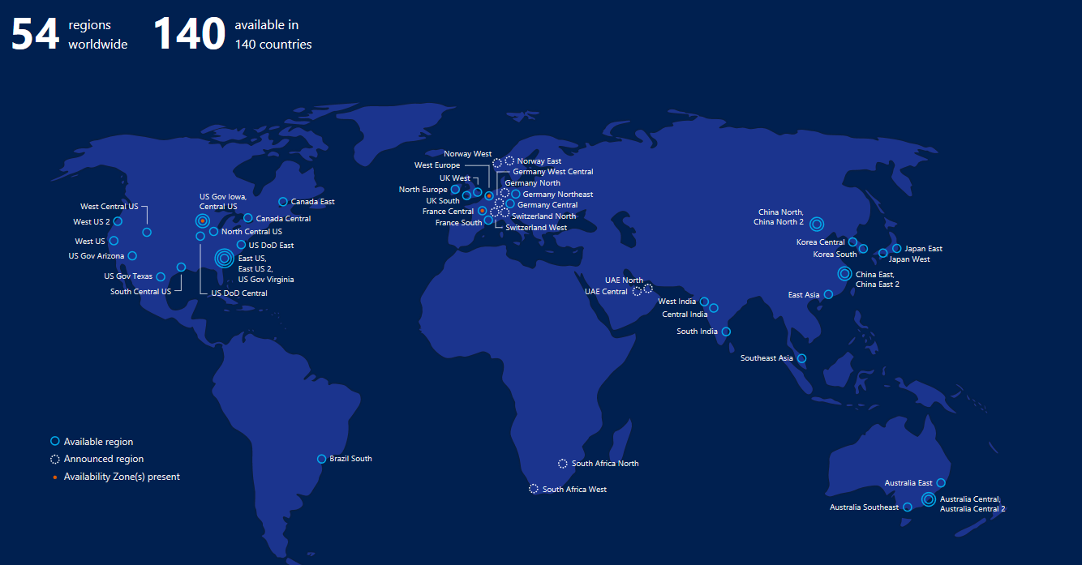
Azure Global Presence
© Microsoft

Slide 5
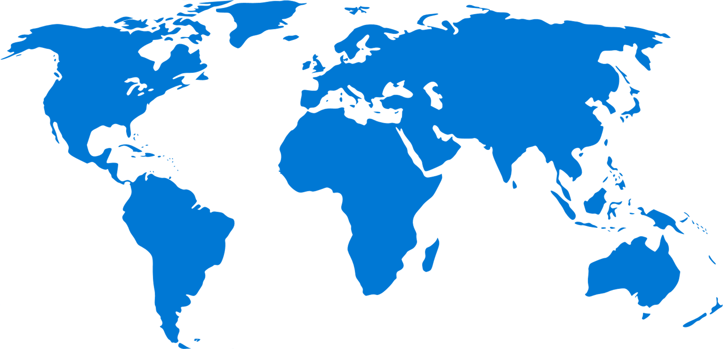
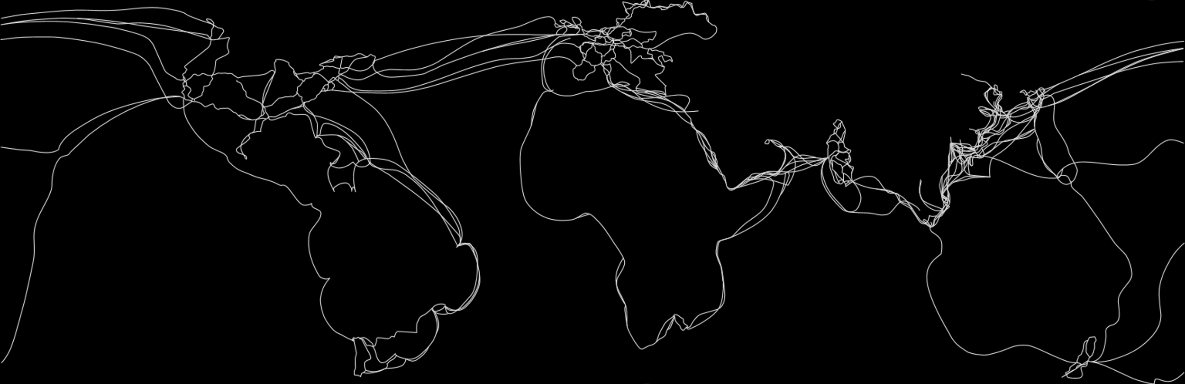
Microsoft Global Network
54
100K+
140+
200+
AZURE REGIONS
MILES OF FIBER AND SUBSEA CABLES
EDGE SITES
EXPRESSROUTE PARTNERs
© Microsoft

Slide 6


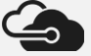
Azure networking
Azure region ‘A’
Regional network
Cable
Consumers
Regional network
CDN
DNS
Microsoft WAN
Edge
Carrier
Enterprise, SMB, mobile
Azure region ‘B’
Regional network
ExpressRoute
Regional network
Internet Exchanges
DNS
Enterprise DC/Corpnet
DC Hardware | Services | Intra-Region | WAN Backbone | Edge and ExpressRoute | CDN | Last Mile
SmartNIC/ FPGA SONiC | Virtual Networks Load Balancing VPN Services Firewall DDoS Protection DNS & Traffic Management | DC Networks Regional Networks Optical Modules | Software WAN Subsea Cables Terrestrial Fiber National Clouds | Internet Peering ExpressRoute | Acceleration for applications and content | E2E monitoring (Network Watcher, Network Performance Monitoring)
Notes:
References:
Inside the Microsoft FPGA-based configurable cloud
https://azure.microsoft.com/en-us/resources/videos/build-2017-inside-the-microsoft-fpga-based-configurable-cloud/
SONiC: The networking switch software that powers the Microsoft Global Cloud
https://azure.microsoft.com/en-us/blog/sonic-the-networking-switch-software-that-powers-the-microsoft-global-cloud/

Slide 7



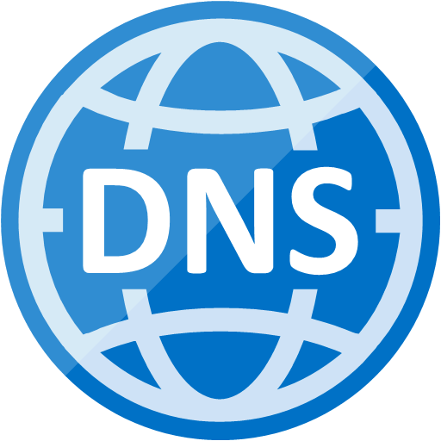





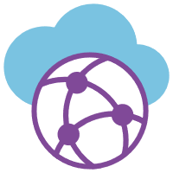
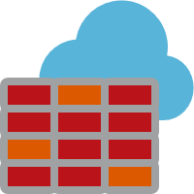


Robust networking infrastructure services
Virtual Network
Provision private networks, optionally connect to on-premises datacenters
VPN Gateway
Establish secure, cross-premise connectivity
ExpressRoute
Dedicated private network fiber connections to Azure
Azure DNS
Host your DNS domain in Azure
Content Delivery Network
Ensure secure, reliable content delivery with broad global reach
Traffic Manager
Route incoming traffic for high performance and availability
Application Gateway/WAF
Build scalable and highly-available web front ends in Azure
Load Balancer
Deliver high availability and network performance to your applications
Azure Front Door Service
Scalable and secure entry point to deliver global web apps
Virtual WAN
Build secure global scale branch connectivity
Azure Firewall
Highly available and scalable cloud-based network security service
DDoS Protection
Protect your applications from Distributed Denial of Service (DDoS) attacks
Network Watcher
Network performance monitoring and diagnostics solution
Notes:
Reference:
Networking Products
https://docs.microsoft.com/en-us/azure/#pivot=products&panel=network

Slide 8


Azure Virtual Networks
Virtual Networks are the primary building block for Azure networking
Private network in Azure based on address space prefix
Bring your own DNS or use Azure-provided DNS
Azure-provided DHCP
Connect on-premises or to the internet
Control traffic flow with user-defined routes (UDR)
Security traffic with network security groups (NSG)
Internet
On-premises
Direct internet
connectivity
Azure
GW
Back-end
10.3/16
Mid-tier
10.2/16
Front-end
10.1/16
AD / DNS
Virtual Network
Notes:
Key capabilities
Isolation and segmentation
Communicate with the internet
Communicate between Azure resources
Communicate with on-premises resources
Filter network traffic
Route network traffic
Connect virtual networks
DHCP
Azure provided/managed service
All addresses are DHCP-based
Address not allocated until object created
Addresses are recovered when object is deallocated
Static addresses are DHCP reservations
Address prefix comes from VNet/subnet definitions
Reference:
What is Azure Virtual Network?
https://docs.microsoft.com/en-us/azure/virtual-network/virtual-networks-overview

Slide 9





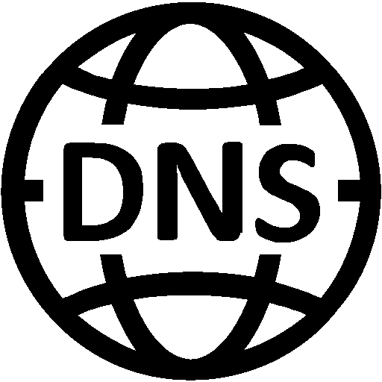

Your Network in Azure
Virtual Network
Virtual Network
Secure per customer virtual datacenter in the cloud
Instantiate and configure complex topologies in minutes
Rich security and networking services
Virtual Network
Internet
Cross premises Connectivity
Virtual Network
Virtual Network
Notes:
Add another slide ➔ Azure Private Workload and Azure Public Services (storage, AAD, Azure Website, SQL Azure, etc.)

Slide 10


Network Interface Card (NIC)
Associated to a VNet Subnet
Private IP address only
Connectivity restricted to VNet
MAC addresses persisted
Direct Public IP association
Can be part of a LB set (internal and external VIP)
All VM sizes support at least 2 NICs
Private IP*
Private IP*
primary
Public IP
Public IP
LB
LB
*multiple mappings

Slide 11
IP addressing models in ARM
Private IP
Public IP
Public Static
Private Static
Internal address assigned by default for Azure for communication within Virtual Networks
Assigned to a VM NIC or Internal Load Balancer
Azure reserves the first three and the last IP from the pool
First usable address of a /24 is .4
Public IP address assigned to a VM NIC or an external Load Balancer
Only exists when a LB is created or address is assigned to VM NIC
This is a static public-facing address that must be specially requested. There are a limited number of these addresses per subscription
Use only when you need a public facing static IP address
A static address allocated from the subnet address pool and is internal-facing only. The number is only limited by the number of addresses assigned to the subnet address pool. This is implemented as a DHCP reservation
Use only when you need an internal facing static IP address
Notes:
Reference:
IP address types and allocation methods in Azure
https://docs.microsoft.com/en-us/azure/virtual-network/virtual-network-ip-addresses-overview-arm

Slide 12
Accelerated Networking
30Gbps
VM to VM bandwidth!
Accelerated Networking
Support expanded to 4 core VMs
Lower latency access to ExpressRoute circuits
No additional cost
Windows & Linux
Region
Azure VM
Azure VM
Accelerated Networking
Accelerated Networking
30Gbps
30Gbps
Notes:
References:
Create a Windows virtual machine with Accelerated Networking
https://docs.microsoft.com/en-us/azure/virtual-network/create-vm-accelerated-networking-powershell
Create a Linux virtual machine with Accelerated Networking
https://docs.microsoft.com/en-us/azure/virtual-network/create-vm-accelerated-networking-cli

Slide 13
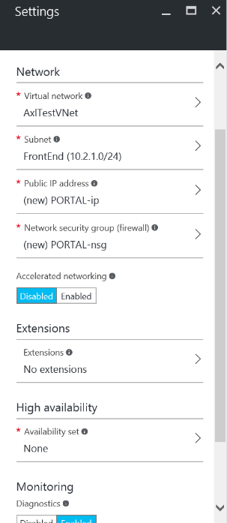
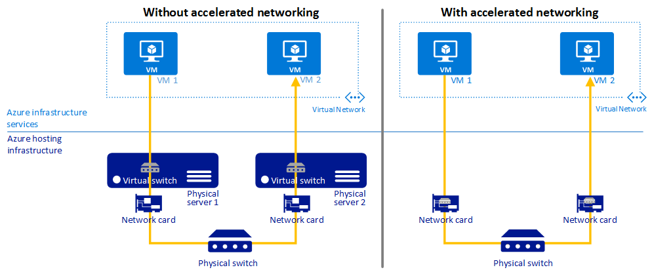
Accelerated Networking benefits
High throughput, low latency network performance
Enables SR-IOV – direct VM-to-NIC path bypassing Hyper-V (Host OS) layer
Lower Latency / Higher packets per second (pps)
Decreased CPU utilization
Reduced jitter
Notes:
References:
Create a Windows virtual machine with Accelerated Networking
https://docs.microsoft.com/en-us/azure/virtual-network/create-vm-accelerated-networking-powershell
Create a Linux virtual machine with Accelerated Networking
https://docs.microsoft.com/en-us/azure/virtual-network/create-vm-accelerated-networking-cli

Slide 14
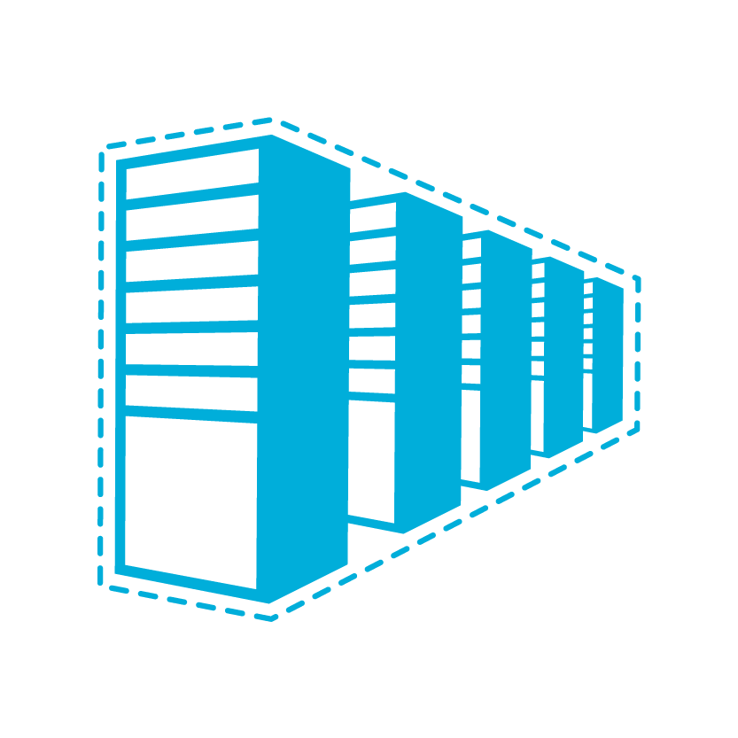


Connecting to Azure
Cloud
Customer
Characteristics
Internet facing with public IP addresses in Azure
DNS, load balancing, DDoS protection, WAF
Internet Connectivity
Remote Access to VNet/On-prem
Connect from anywhere
Mac, Linux, Windows
Radius/AD authentication
Point-to-site (P2S) VPN connectivity
High throughput, secure cross-premises connectivity
BGP, active-active for high availability & transit routing
Site-to-site (S2S)
VPN connectivity
Private connectivity to Microsoft services (O365, Azure PaaS services)
Mission critical workloads
ExpressRoute private connectivity

Slide 15
Connecting in Azure
Cloud
Customer
Characteristics
Same-/cross-region direct, private VM-to-VM connectivity
NSG & UDR across VNets
GatewayTransit for hub-and-spoke
VNet Peering
Transitive routing via BGP and VPN gateways
Secure connectivity via IPsec/IKE across Azure WAN links
VNet-to-Vnet (V2V) VPN
Networking as a service
optimized and automated branch-to-branch connectivity through Azure
Virtual WAN

Slide 16
What is VNet peering?
A mechanism that connects 2 through the Azure backbone network.
Two types:
VNet peering - connecting VNets within the same Azure region
Global VNet peering - connecting VNets across Azure regions
Peered VNets are still managed as separate resources,
Virtual machines in these Vnets can communicate with each other directly by using private IP addresses.
Notes:
Reference:
Virtual network peering
https://docs.microsoft.com/en-us/azure/virtual-network/virtual-network-peering-overview

Slide 17
What is VNet peering?
Ability to “merge” two Azure VNets, so that VMs in the two VNets can communicate with each other as if they were on the same VNet
VNET1
VNET2
Subnet1
Subnet2
Subnet1
Subnet2
VM1
VM3
VM4
VM1
VM3
VM4
VM5
VM5
VM2
VM6
VM2
VM6
Switch/Routing
Notes:
VNet peering key facts
Traffic across peering VNets is managed in a very similar way to intra-VNet traffic
Provides the same performance as intra-VNet traffic
At least one of the two VNets must be ARM
The virtual networks that are peered should have non-overlapping IP address spaces.
Low-latency & high-bandwidth
The ability to use resources such as network appliances and VPN gateways as transit points in a peered VNet.
The ability to connect a virtual network that uses the ARM model to a virtual network that uses ASM and enable full connectivity between resources
Latency & Bandwidth
The network latency for a round trip between 2 VMs in peered VNets is the same as for a round trip within a local Vnet.
The network throughput is based on the bandwidth that's allowed for the virtual machine proportionate to its size.
The traffic between the virtual machines in peered VNets is routed directly through the Azure back-end infrastructure and not through a gateway.
Reference:
Virtual network peering
https://docs.microsoft.com/en-us/azure/virtual-network/virtual-network-peering-overview

Slide 18
VNet peering is non-transitive
VNET1
VNET2
VNET3
Peering
Peering
VNet1 can send/receive traffic to/from VNet2
VNet2 can send/receive traffic to/from VNet1, VNet3
VNet3 can send/receive traffic to/from VNet2
VNet1 cannot send/receive traffic to/from VNet3

Slide 19
VNet peering is non-transitive: Hub&Spoke
HR VNET
Peering
All VNets can communicate with the Hub VNet, but HR, Marketing and Engineering cannot “talk” to each other
Marketing VNET
Hub site
(shared services)
Peering
Peering
Engineering
VNET

Slide 20
VNet peering: Gateway transit
A VNet’s ability to route traffic which has not been originated in it and is not destined to it
VNET1
VNET2
Peering
Virtual Network Gateway
IPSec or ER
On-Prem
VM A
*Does not work for Global VNet peering

Slide 21
Hub and spoke topology
Use Remote GW
Use Remote GW
Azure VNet 2
Azure VNet 3
Azure VNet 1
Allow GW Transit
Allow Forwarded Traffic
Gateway
This applies both to ER and S2S hybrid scenarios
Non-transitive nature: VNet 2 and VNet 3 cannot communicate
VPN
On-Premises
Notes:
Reference:
Implement a hub-spoke network topology in Azure
https://docs.microsoft.com/en-us/azure/architecture/reference-architectures/hybrid-networking/hub-spoke
Implement a hub-spoke network topology with shared services in Azure
https://docs.microsoft.com/en-us/azure/architecture/reference-architectures/hybrid-networking/shared-services

Slide 22
Large scale, multi-platform P2S VPN
P2S VPN connections
SKU | P2S – IKEv2* | P2S – SSTP | S2S/V2V | Throughput
VpnGw3 | *Contact support | 128 | Max. 30 | 1.25Gbps
VpnGw2 | *Contact support | 128 | Max. 30 | 1.00Gbps
VpnGw1 | *Contact support | 128 | Max. 30 | 650Mbps
Basic | N/A | 128 | Max. 10 | 100Mbps
P2S with IKEv2
Windows 10 & Windows Server 2016*
Linux & Android via StrongSwan
Mac (macOS 10.12 and higher)
Radius/AD authentication
Username/password
Certificate-based (EAP-TLS)
MFA via NPS extension + Azure MFA
Notes:
*IKEv2 is supported on Windows 10 and Server 2016. However, in order to use IKEv2, you must install updates and set a registry key value locally. OS versions prior to Windows 10 are not supported and can only use SSTP.
Reference:
About Point-to-Site VPN
https://docs.microsoft.com/en-us/azure/vpn-gateway/point-to-site-about

Slide 23
Site-to-site VPN Gateways
SKU | Workload | Throughput* | S2S/V2V | SLA
VpnGw1 | Production | 650 Mbps | Max. 30 | 99.95%
VpnGw2 | Production | 1 Gbps | Max. 30 | 99.95%
VpnGw3 | Production | 1.25 Gbps | Max. 30 | 99.95%
Basic | Dev/Test | 100 Mbps | Max. 10 | 99.9%
Type
Route-based – router (IKEv2)
Policy-based – firewall (IKEv1)
SKUs
Mainly differentiate on throughputs
Same feature sets (except Basic)
Features
BGP, transit routing, forced tunneling
Gateway transit
Active-active
Custom policy – IPsec/IKE

Slide 24


Site-to-Site VPN connectivity
Extend your premises to the cloud securely
On-ramp for migrating services to the cloud
Use your on-premises resources in Azure (monitoring, AD, …)
Microsoft Azure
<subnet 1>
<subnet 2>
<subnet 3>
Virtual Network
DNS server
Site-to-site VPN
On-premises
VPN Gateway
HA VPN Gateway
Hardware VPN or Windows RRAS
Your datacenter

Slide 25
S2S VPN gateway redundancy
Zero downtime during planned maintenance
From active-standby to active-active
Support both cross-premises and VNet-to-VNet connectivity
Spreading traffic over multiple tunnels simultaneously
VNet1
East US
ASN 65010
10.11.0.0/16
10.11.0.0/16
Azure VPN
On Premises VPN 1
On Premises
Site 5
ASN65050
10.51.0.0/16
10.52.0.0/16
Azure VPN 2
On Premises VPN 2
Notes:
Reference:
Highly Available Cross-Premises and VNet-to-VNet Connectivity
https://docs.microsoft.com/en-us/azure/vpn-gateway/vpn-gateway-highlyavailable

Slide 26









ExpressRoute
✔ Unified connectivity to Microsoft Cloud Services
✔ Predictable performance
✔ Enterprise-grade resiliency and with SLA for availability
✔ Large and growing ExpressRoute partner ecosystem
Customer’s Network
Partner Edge
Primary Connection
Microsoft Edge
Secondary Connection
ExpressRoute Circuit
Microsoft Peering for Office 365, Dynamics 365, Azure public services (public IPs)
Azure Private Peering for Virtual Networks

Slide 27

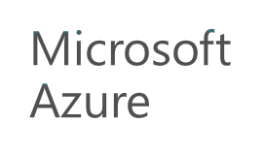


ExpressRoute connectivity models
ExpressRoute
ExpressRoute
ExpressRoute
ExpressRoute Direct
WAN
Cloud exchange co-location
Point-to-point Ethernet connection
Any-to-any (IPVPN) connection
ExpressRoute Peering Location
Notes:
Many different connectivity models utilizing our over 200 service provider ecosystem
-peering locations across the world near Azure regions and covering major user metros now

Slide 28
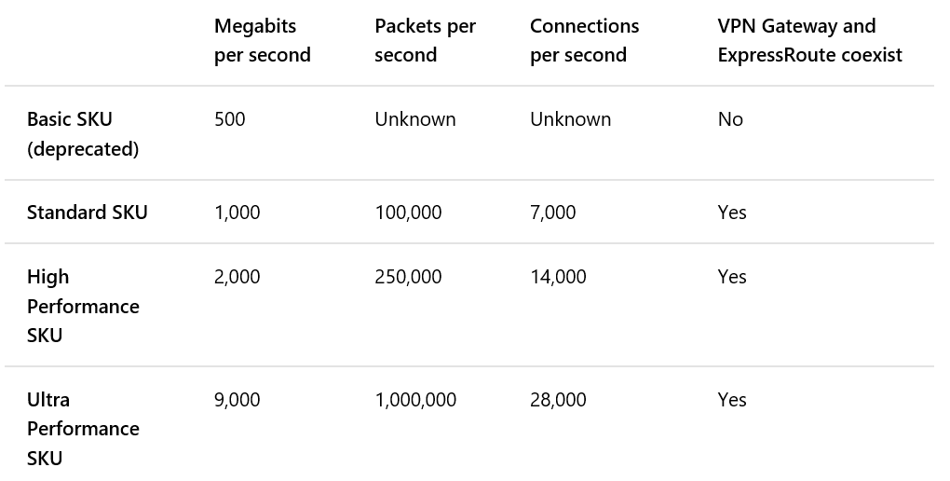
ExpressRoute gateways
Notes:
Reference:
About virtual network gateways for ExpressRoute
https://docs.microsoft.com/en-us/azure/expressroute/expressroute-about-virtual-network-gateways

Slide 29
ExpressRoute considerations
Understand the models
Differences between unlimited data and metered data
Understand what model you are using today to accelerate adoption
Understand the differences in available port speeds, locations, and approach
Understand the limits that drive additional circuits
Understand the providers
Each offer a different experience based on ecosystem and capabilities
Some provide complete solutions and management
Understand the costs
Connection costs can be broken out by the service connection costs (Azure) and the authorized carrier costs (telco partner)
Unlike other Azure services, look beyond the Azure pricing calculator
Notes:
ExpressRoute circuit limits
10 VNets/circuits
1 VNet can be connected to 4 different circuits
1 circuit across 10 subscriptions
10 dedicated circuits per subscription
Some customers prefer vendors which can support the Exchange Provider peering model while others prefer the Network Service Provider model which establishes MPLS connectivity.
Make sure to obtain the complete end-to-end cost.
Note that in the Exchange Provider model, the customer is responsible for managing routes where NSP the provider manages routes.

Slide 30
Unlimited versus metered
Unlimited
Speeds from 50 Mbps to 10 Gbps
Unlimited inbound data transfer
Unlimited outbound data transfer
Higher monthly fee
Metered
Speeds from 50 Mbps to 10 Gbps
Unlimited inbound data transfer
Outbound data transfer charged at a predetermined rate per GB
Lower monthly fee

Slide 31





Azure Virtual WAN – Unified Cloud Connectivity
Overview
VNet
Large scale Internet VPN for branch offices
ExpressRoute for datacenters / HQ
P2S VPN for mobile workers
Local Internet breakout for O365
Ecosystem of SDWAN/VPN partners
Preview features
ExpressRoute
P2S with IKEv2 and OpenVPN
O365 policy
VNet
Corp HQ
VNet
ExpressRoute
Datacenter
ExpressRoute
ER/VPN
ER/VPN
ER/VPN
Internet
Region 1
Region 2
Region 3
Internet
Branch
Branch
Branch
Branch
Notes:
Branch office connect using Ipsec – see limits of 2 to 4 Gbps
For larger offices and DC you may need higher throughput OR locations that don’t have good Internet ExpressRoute is a good option.

Slide 32

Azure Virtual WAN Ecosystem
Coming soon
Notes:
Embracing a new era of distributed cloud connectivity
Ease of use
Automated configuration management
Simplified policy management
Talking points
We are excited by the partners who are available now with deep integration. In the Virtual WAN session you will learn more about their integration.
We also have an expanding set of coming soon partners who are working on integration. Our customers most often ask us about two and we are excited to announce Vmware is joining our ecosystem of partners.

Slide 33
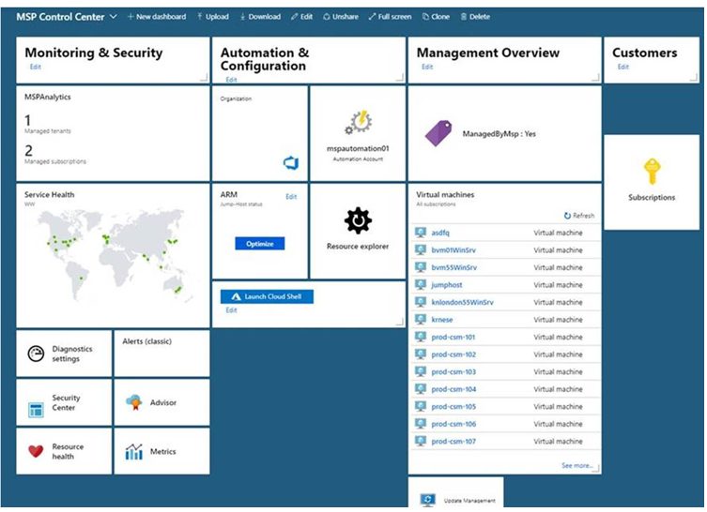

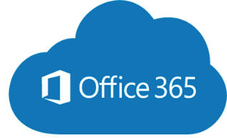




Traditional WAN
Azure Virtual WAN
Azure
Azure
VNet
MSP/Carrier Delivered
Managed Network Services
VNet
VNet
VNet
VNet
West
vWAN
Hub
East
vWAN
Hub
ExpressRoute
Carrier WAN/MPLS/VPN
ExpressRoute
Business Class
Internet
(Microsoft Peering Service)
Carrier WAN/MPLS
VPN
S2S VPN/SDWAN CPE
P2S VPN
HQ/DC
Branch
Branch
Remote Users
Redmond
HQ Branch
Branch
Branch
Branch
Remote Users
Microsoft Confidential
Traffic Backhauled to HQ
Remote User

Slide 34
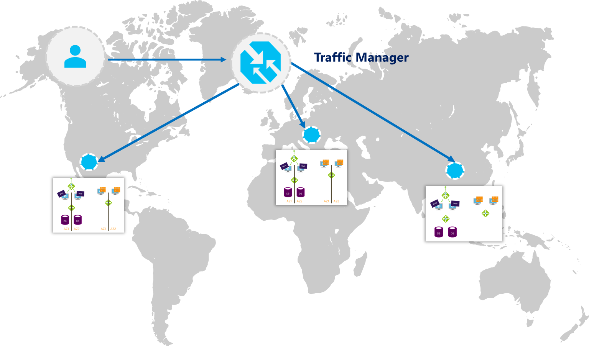
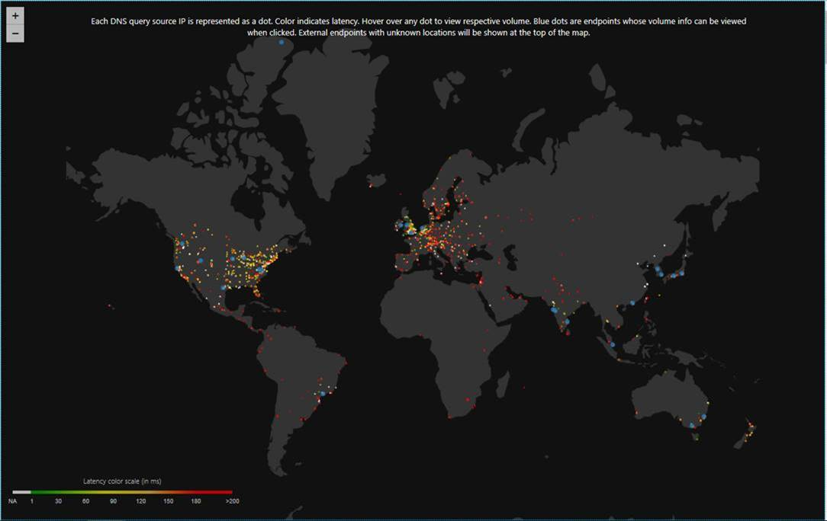
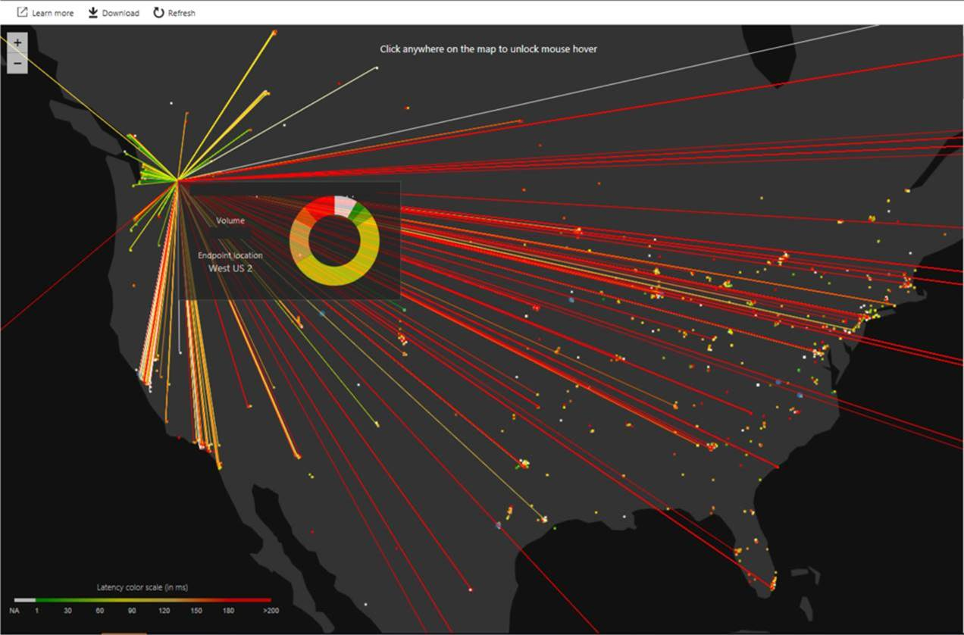
Traffic Manager
DNS request routing
Easy Onboarding
Multiple Routing Methods
Endpoint monitoring
High resiliency
Real User Measurement & Traffic View
Routing based on profiles
Priority
Weighted Round Robin
Geographic
Performance
Diagnostics and Probes
Traffic View visualization
Understand the volume of traffic generated by your users and the latency experienced by them, at a per region level
TCP & HTTP health probes
Notes:
References:
What is Traffic Manager?
https://docs.microsoft.com/en-us/azure/traffic-manager/traffic-manager-overview
Traffic Manager Traffic View
https://docs.microsoft.com/en-us/azure/traffic-manager/traffic-manager-traffic-view-overview

Slide 35
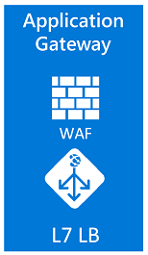
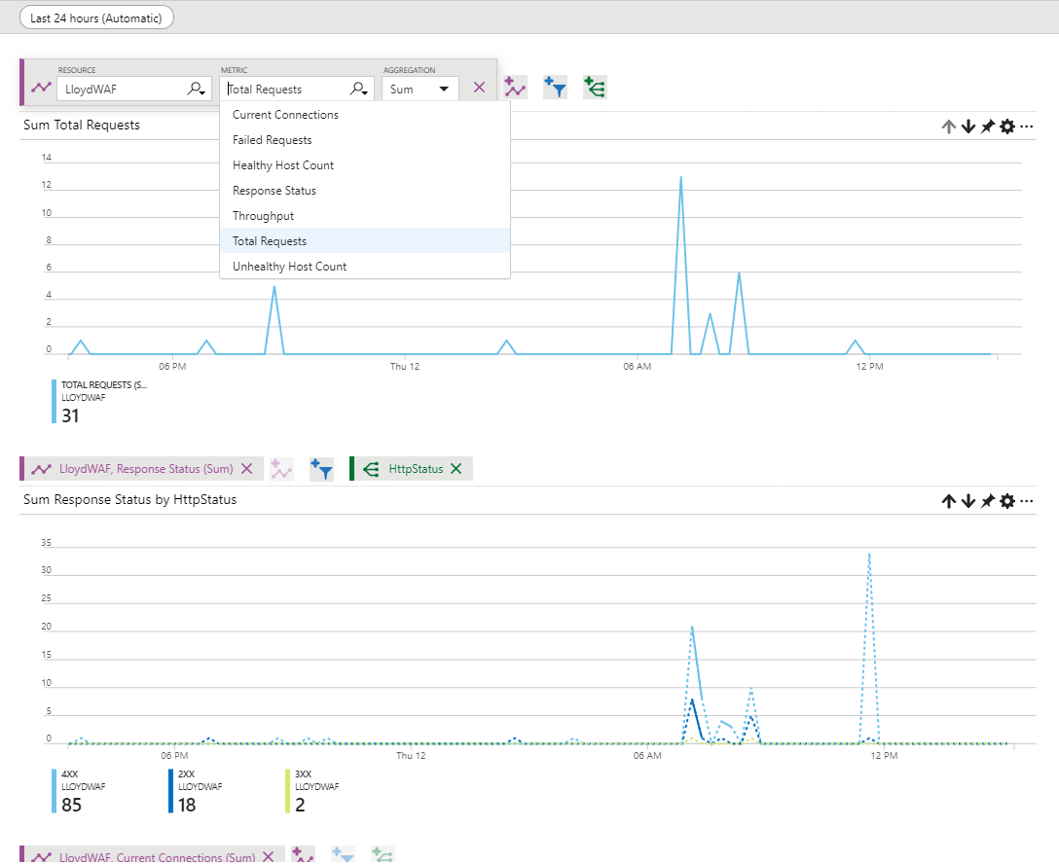
Application Gateway
fabrikam.com
Layer 7, per request routing
HTTP round robin
Cookie based session affinity
Multi-site hosting
URL based routing
Application layer security
SSL termination
SSL Policy (protocol version and cipher)
End to end SSL
Web Application Firewall (OWASP)
Diagnostics and Probes
Access, performance, backend health logs
Monitor metrics & alerts: Total request, Failed requests, Healthy/Unhealthy host counts, Response status distribution (2xx, 3xx, 4xx, 5xx), Throughput
Custom health probes (HTTP, HTTPS)
Support Web Apps
Redirection
Videos
contoso.com
fabrikam.com
Images
contoso.com/video/*
contoso.com/images/*
Notes:
AppGw is platform managed, dedicated deployment. Azure takes care of availability, patching, management of these deployments for you.
Application Gateway like ALB is regional in scope but has more advanced connectivity options. You are not limited to scale sets or VNets.
AppGw can be deployed as both public facing or internal ILB only. More importantly you can use AppGw with both end points exposed at the same time to function as both internal and external layer 7 ADC.
AppGw is a SSL terminating reverse proxy which offers many functionalities.
It is difficult to list down all the capabilities in one chart but here is an attempt. We offer layer 7 routing capabilities like
true round robin load distribution on per http request basis
Ability to pin a user session to the same VM even when originating traffic is behind CDN or proxy
Ability to host multiple sites behinds the same Application Gateway
And many more
Reference:
What is Azure Application Gateway?
https://docs.microsoft.com/en-us/azure/application-gateway/overview

Slide 36
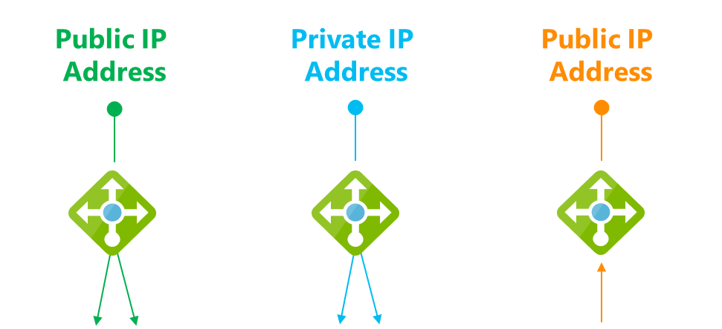

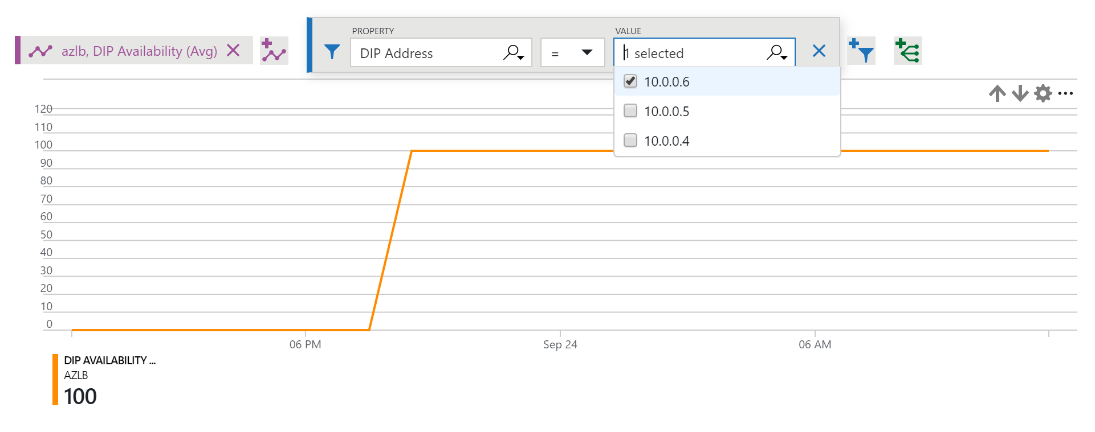
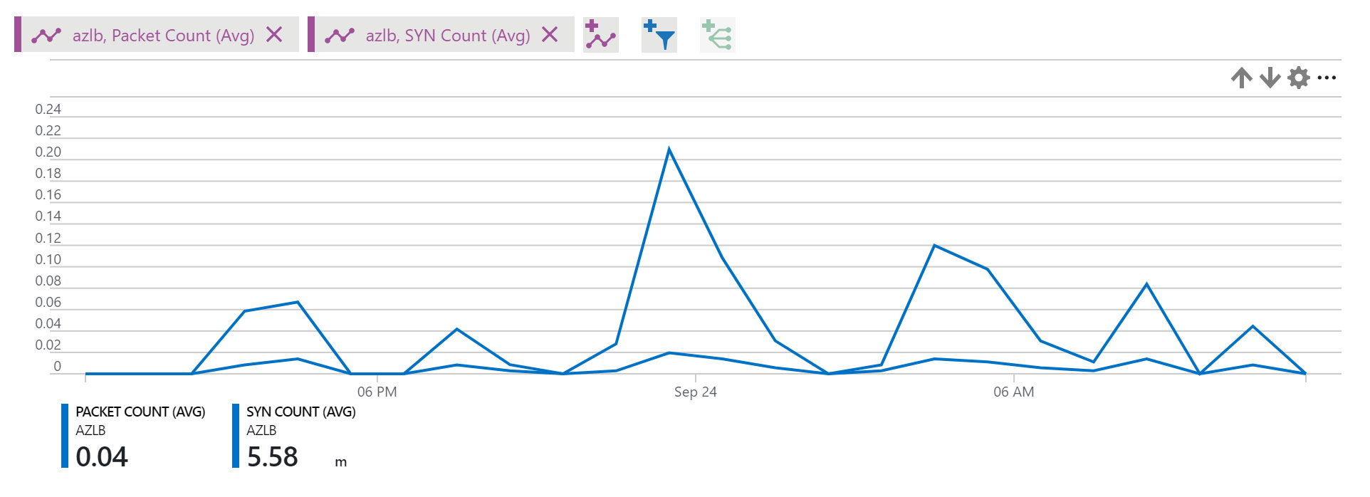
Load Balancer
Layer 4, per flow
All TCP & UDP applications
Inbound & outbound
Flow-based Load Balancing with Health Probing
Inbound NAT rules (port forwarding)
Availability Zones support
HA Ports load balancing
2 SKUs: Standard & Basic
High performance
Part of the Azure SDN stack, not a VM
Low latency
High throughput
Outbound bandwidth only limited by VM in pool
Diagnostics and Probes
Multi-dimensional metrics and alerts in Azure Monitor
TCP & HTTP health probes, Data path health
F
3 key scenarios
Notes:
Reference:
What is Azure Load Balancer?
https://docs.microsoft.com/en-us/azure/load-balancer/load-balancer-overview

Slide 37

Azure Firewall
Cloud native stateful Firewall as a service
A first among public cloud providers
L3-L7 Connectivity Policies
Spoke 1
NAT, Network and Application traffic filtering rules allows Inbound/Outbound access
Central governance of all traffic flows
Built-in high availability and auto scale
Network and application traffic filtering
Centralized policy across VNets and subscriptions
Complete VNET protection
Filter Outbound, Inbound, Spoke-Spoke & Hybrid Connections traffic (VPN and ExpressRoute)
Centralized logging
Archive logs to a storage account, stream events to Event Hub, or send them to Log Analytics or Security Integration and Event Management (SIEM) system of choice
Central VNet
Spoke2
Azure Firewall
Spoke VNets
Azure to On-Prem traffic filtering
Traffic is denied by default
On-Premises
Notes:
Easily configure connectivity policies for all your resources using network & application (fully qualified domain name filtering) rules
Both inbound and outbound support and NAT (SNAT and DNAT)
FQDN Tags support (e.g. Windows Update, ASE) to allow easy rule creation
Deployed in a click; fully integrated with the Azure Platform

Slide 38

Azure Web Application Firewall Protect web sites from common application vulnerabilities
Platform managed WAF
Built in high availability and scalability
Protect application
SQL Injection, XSS, protocol violation & others
Near real time monitoring
Azure Monitor & Azure Security Center
WAF managed rules
OWASP Core Rule Set 3.0 and 2.2.9 native support
Site 1
×
XSS attack
Valid request
WAF
Valid request
Site 2
×
Valid request
New features
WAF Configurability
Control request body evaluation
Control request and file sizes
WAF Exclusion List
Exclude request attributes from WAF evaluation
Apply to request header/cookies/parameters
SQL Injection
L7 LB
Application Gateway & WAF

Slide 39
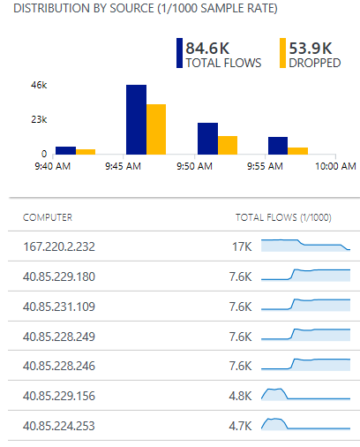
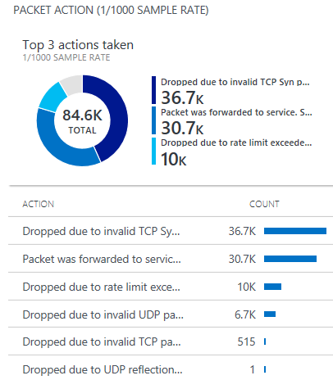
Azure DDoS Protection
Cloud scale DDoS protection tuned to applications
Simple to provision for all your virtual network resources
Always on monitoring with near real time telemetry and alerting
Automatic network layer attack mitigation
Protection policies tuned to your application’s traffic profile
What’s new
DDoS Attack Analytics
Near real time network attack mitigation flow logs
Attack data snapshots and full post attack summary
DDoS Rapid Response
Specialized Rapid Response team support during active attacks
Custom mitigation policy configuration
Azure Security Center integration
Intelligent DDoS Protection virtual network recommendation
Attack flow logs Azure Log Analytics view

Slide 40
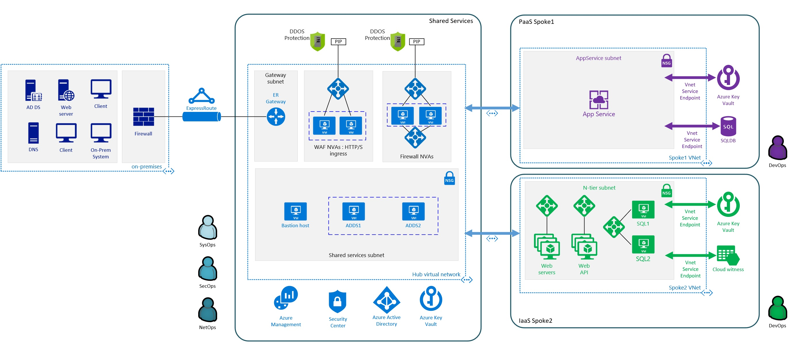





Sample solution using Azure protection services
Shared Services
PaaS Spoke 1
DDOS Protection
DDOS Protection
PIP
PIP
AppService subnet
NSG
Gateway subnet
WAF: HTTP/s ingress
Egress
Ingress (non-http/s) Spoke-Spoke
Spoke-On-Prem
Azure Key Vault
AD DS
Web server
Client
ExpressRoute
NSG
App Service
Firewall
ER Gateway
Application Gateway
Azure firewall
SQLDB
Spoke1 VNet
DNS
Client
On-prem system
DevOps
On-premises
Iaas Spoke2
Shared services subnet
N-tier subnet
Native Security Services DDoS Protection for Public IPs
App GW WAF—Web Application Protection Azure Firewall—Full VNET egress and ingress (non-http/s) protection
NSG—Internal VNET segmentation
Service Endpoints—Secure access to public PaaS resources
NSG
NSG
SysOps
Bastion host
ADDS1
ADDS2
SQL1
Vnet Service Endpoint
Azure Key Vault
Hub virtual network
Web servers
Web API
SQL2
Vnet Service Endpoint
Cloud witness
SecOps
Spoke2 VNet
NetOps
Azure Management
Security Center
Azure Active Directory
Azure Key Vault
DevOps

Slide 41
Azure DNS
Azure DNS
Manage DNS seamlessly with your Azure services
Globally distributed architecture, resilient to multiple region failure
Fast global DNS name resolution
99.99% Availability SLA
All common DNS record types
A, AAAA, CNAME, MX, NS, PTR, SOA, SRV, and TXT
Flexible DNS management
Integrated with Azure Resource Manager for role-based access control, tagging, and template-based deployment—for both zones and record sets
Azure Portal, PowerShell, and CLI
REST API and SDKs for application integration
Notes:
Reference:
What is Azure DNS?
https://docs.microsoft.com/en-us/azure/dns/dns-overview

Slide 42
Azure Private DNS ^{PREVIEW}
Private Queries
Azure Cloud
VNETs
Azure Security Center and Firewall
Query logging
Private DNS Resolution
Conditional Forwarding
Security and threat mitigation
Queries to internet
OnPremise /
Private Cloud
Express Route / VPN
DNS queries from
customer network
Notes:
References:
Use Azure DNS for private domains
https://docs.microsoft.com/en-us/azure/dns/private-dns-overview
Azure DNS Private Zones scenarios
https://docs.microsoft.com/en-us/azure/dns/private-dns-scenarios

Slide 43









Building for global scale
Web applications
Hybrid, Geo and Streaming
Maximize global reliability and performance with cross-region and zonal redundancy.
Migrate to the cloud with across regional and on-prem resources.
Global
Preview
Global
Traffic Manager
Front Door
+
+
Regional
Application Gateway
On Prem
Regional
Load Balancer
+
Internal
Load Balancer
Web Apps
API Apps
Mobile Apps
Functions
Logic Apps

Slide 44

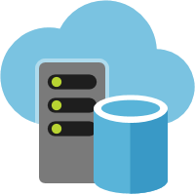
Azure Front Door Service
Your global entry-point to the cloud
Application acceleration
HTTP proxy at the edge of Microsoft’s global network
Reduce latency and improve throughput for your app
Scale out with massive SSL offload
Supports IPv6
Global HTTP/S load balancing
Active probing with global instant failover
Path based routing for microservices
Request rate limiting
Sticky, weighted and priority routing
Global insights
Central traffic dashboard
Regional backend health

Slide 45
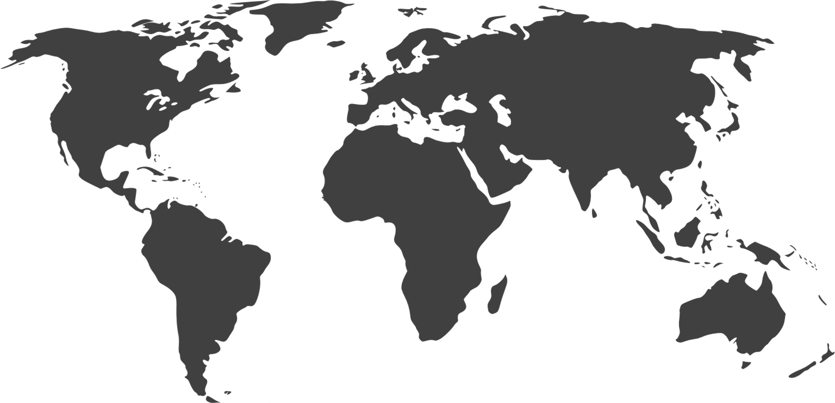
Azure CDN
Cloud native CDN offering giving access to Microsoft global WAN
Azure Key Vault for custom certificates
Adding to Azure CDN’s choice of top CDNs
Mix and match CDN infrastructures
Increase global reach
Redundant CDNs for your service
CDN POP
Multiple CDN POPs
Regional Cache
64
GLOBAL
METROS
36
130+
COUNTRIES
EDGE SITES
and growing!
Notes:
Add bullet that lands “customer option”, “mix and match”
Add word “family”

Slide 46
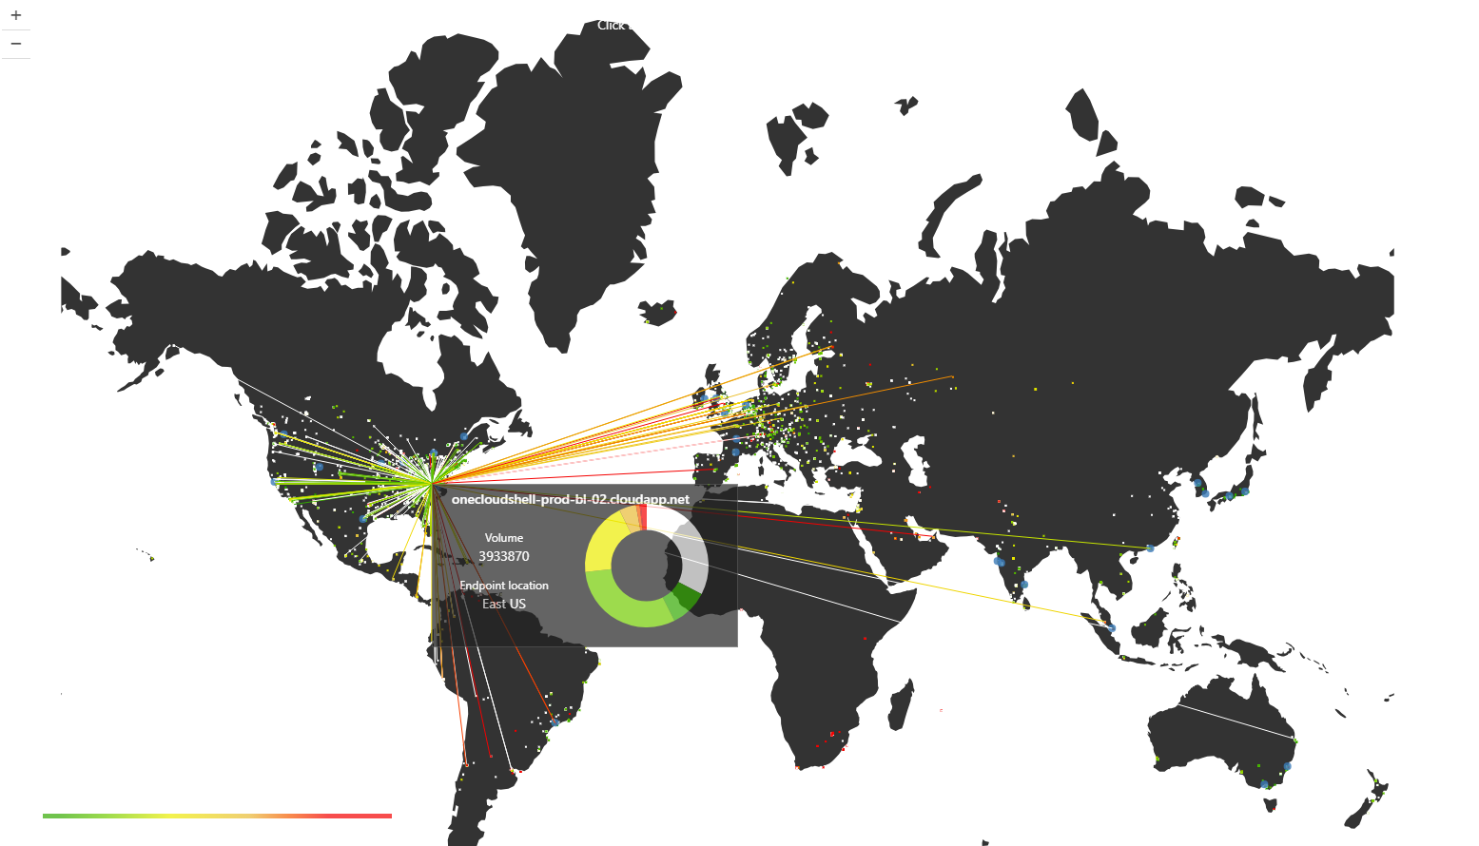



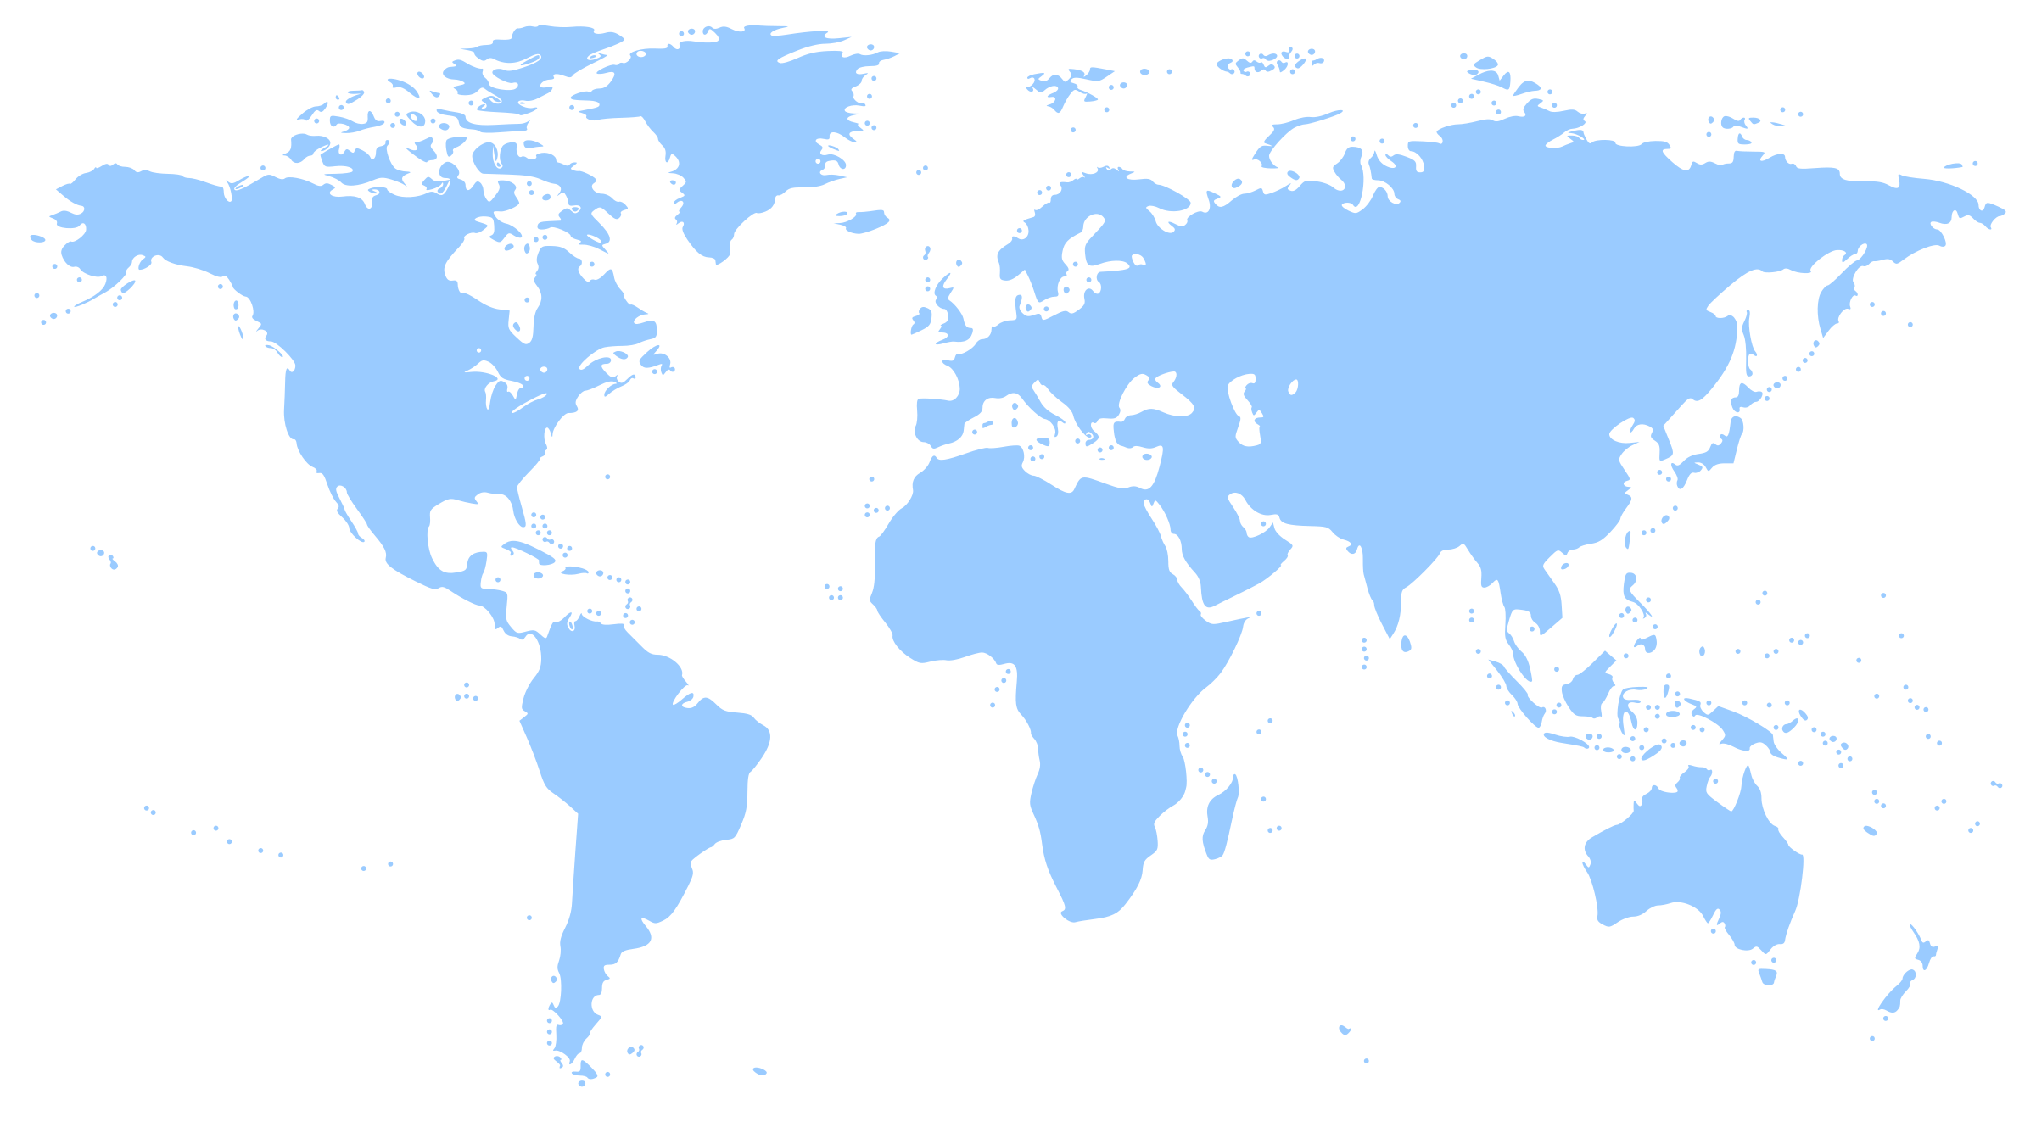



Azure Traffic Manager – DNS based Load Balancing
Smart Traffic Engineering for Azure and external endpoints
Intelligent Routing
Geo, Subnet, Failover, Latency & Weighted
Traffic View
Actionable Insights
on real time data
Analytics and Logs
Identify patterns &
detect threats
What’s new
Add your endpoints using IPv4 / IPv6 addresses
Multi-value responses for increased availability
Route traffic to multi-tenant endpoints using custom headers
Specify custom HTTP response codes to indicate endpoint health
Subnet routing: Deliver customized content for ISPs or corporate offices

Slide 47


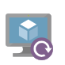




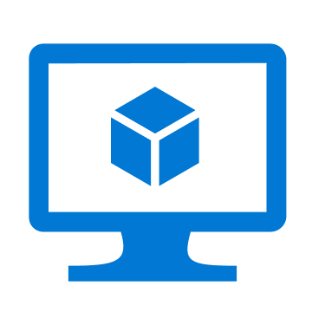








Network Monitoring
Visualize
Monitor & Troubleshoot
Respond
Dashboards
Network Topology
Connection Monitor
ER Monitor
VPN Troubleshoot
Alerts
Autoscale
Analyze
Integrate
Connection Troubleshoot
Packet Capture
Metrics Explorer
Traffic Analytics
Event Hubs
Logic Apps
3rd Party
Azure Monitor
Resource Health
Activity logs
Virtual Network TAP
NSG Flow logs
Network Watcher
ExpressRoute
Monitor
Notes:
Need context

Slide 48


Diagnostics: Two major options, and more
Monitor
all of Azure
metrics & alerts
multi-dimensional
group, filter as needed
export to others
Network Watcher
scenario based
visualize and troubleshoot
investigate deeper
w/ packet captures etc

Slide 49

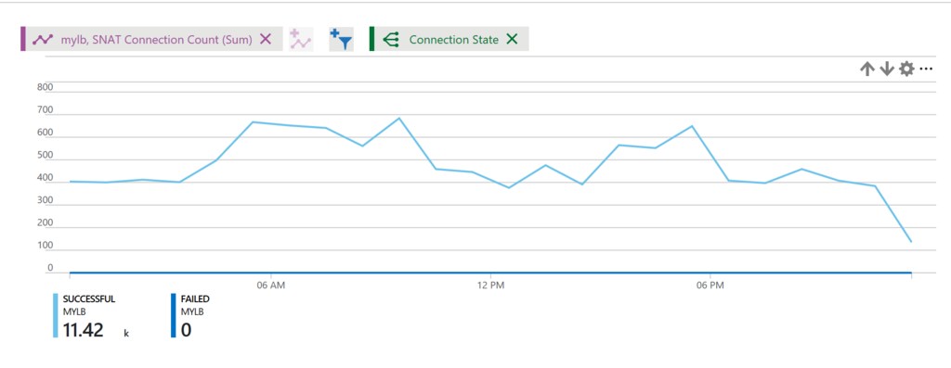
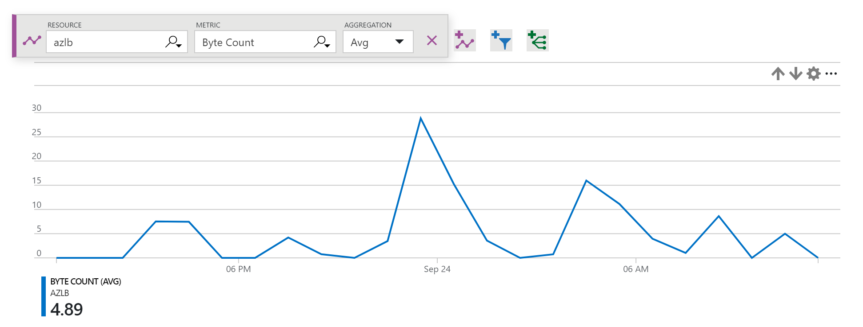
Example: Standard LB metrics
Azure Monitor
Group & filter Metrics & Alerts
Health probe status
Outbound connection health (SNAT success/failure)
Packet counters, connection attempts (TCP SYN)
Byte counters

Slide 50
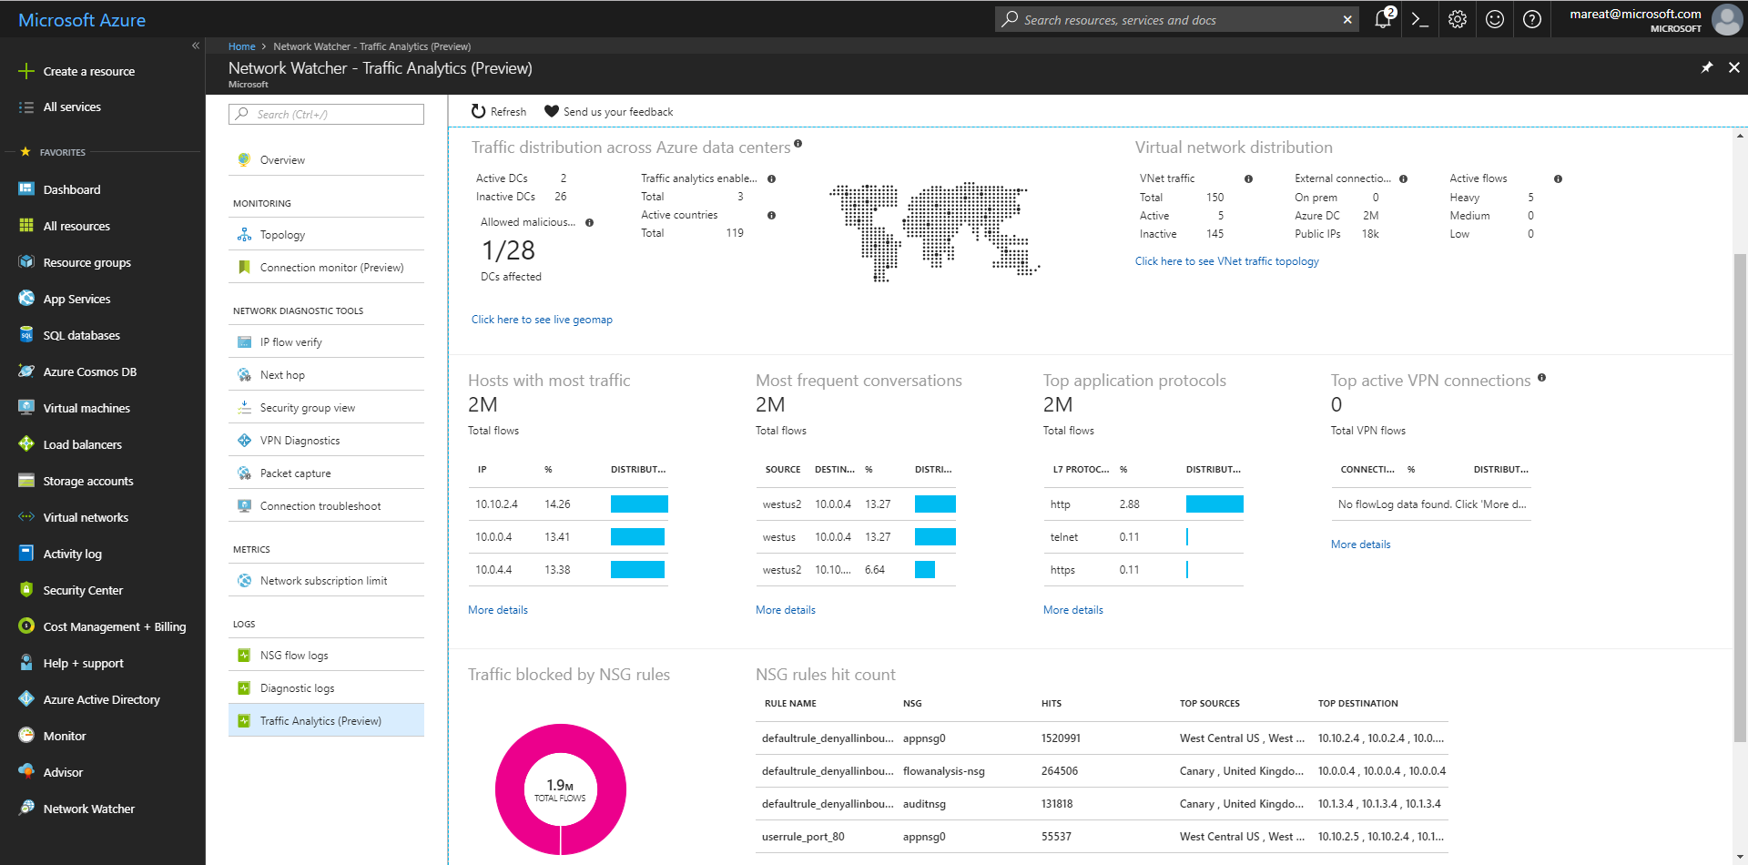
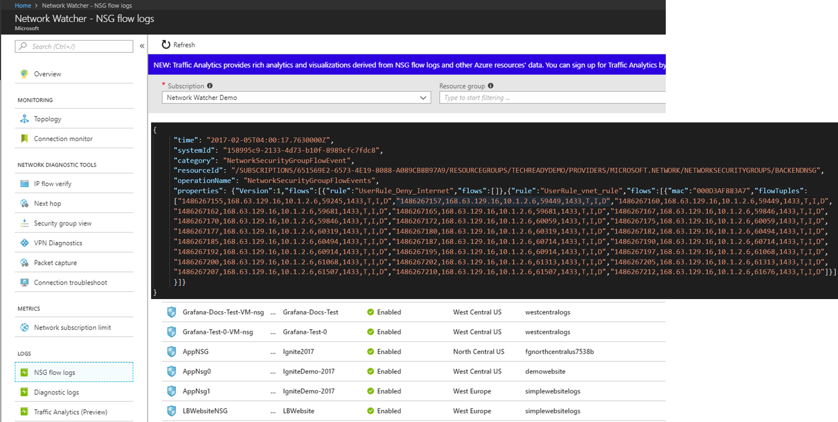
Network Watcher: Visualize and Troubleshoot
Notes:
Reference:
What is Azure Network Watcher?
https://docs.microsoft.com/en-us/azure/network-watcher/network-watcher-monitoring-overview

Slide 51
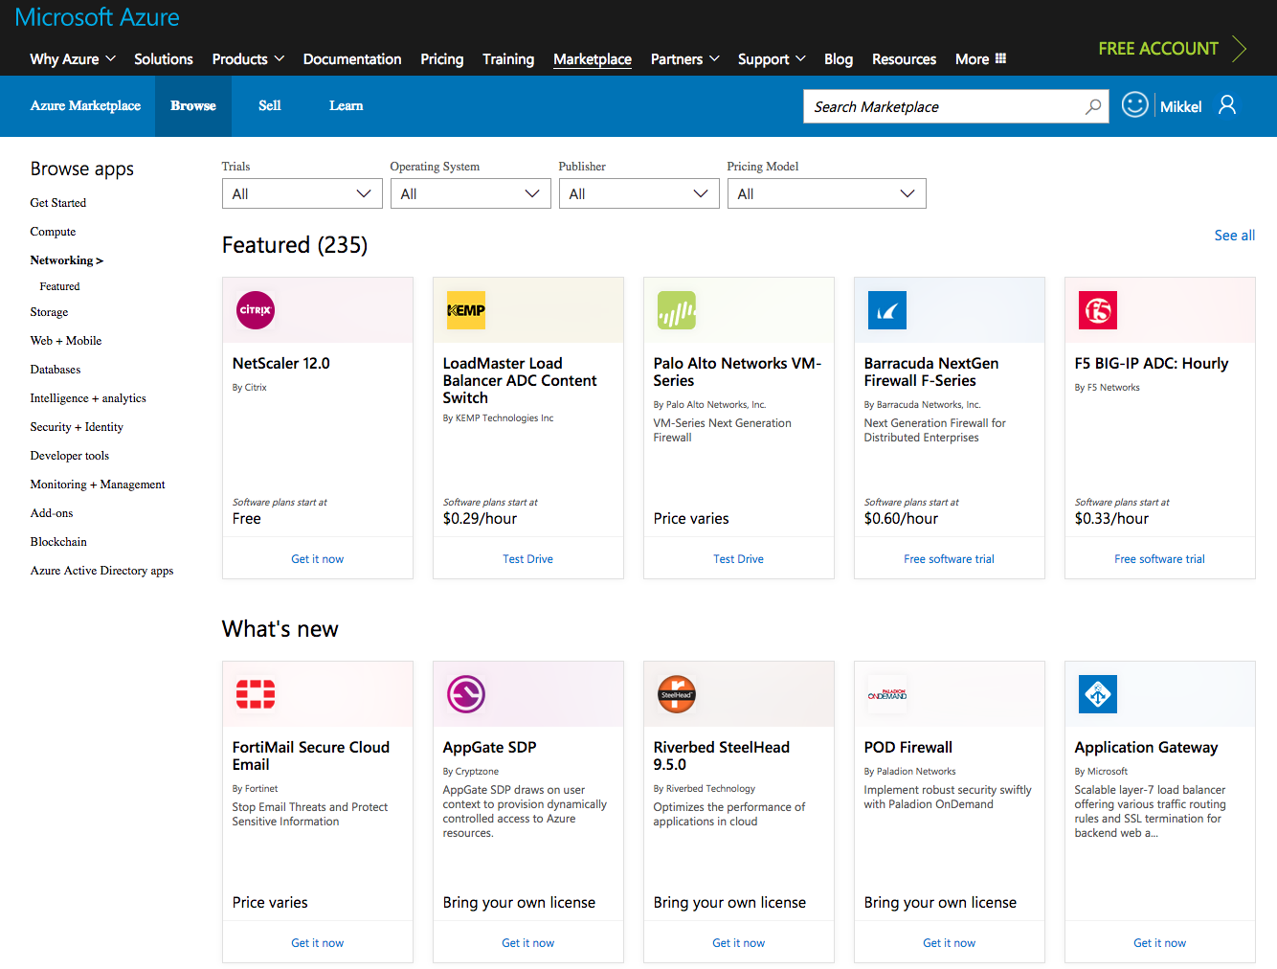
Network Virtual Appliances
Best-of-breed partner appliances in the Azure Marketplace
Extend on premises to Azure using a familiar feel
Easy to deploy, configure and manage
© Microsoft

Slide 52
Network needs are changing
High bandwidth connections for massive data ingestion
Network As A Service – Internet & SDWAN
Deliver
Protect
Connect
Monitor
Protecting distributed web applications
Rise of increasingly sophisticated attack vectors
Visibility and instant alerts on network anomalies
Rich traffic analytics
Create the best user experience
Insights and analytics to boost performance

